Slide 1

Think of a Bicycle

Slide 2

Think of a Tandem Bike

Slide 3

Think of a Racing Bike

Slide 4

Think of a Mountain Bike

Slide 5
Thinking About Bicycles
A tandem bicycle is a kind of bicycle
  Bicycle with two seats
A mountain bicycle is a kind of bicycle
  Bicycle with shocks
A racing bicycle is a kind of bicycle
  Lightweight aerodynamic construction
Tandem, mountain, and racing bicycles are specialized bicycles

Slide 6
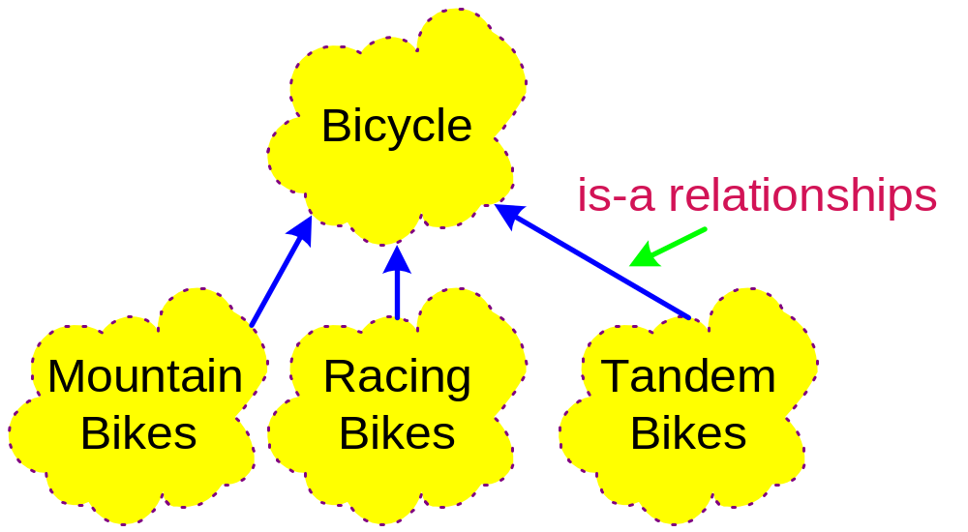
Inheritance
Ability to define new classes of objects using existing classes as a basis
Ability to define new classes of objects using existing classes as a basis
  The new class inherits the attributes and behaviors of the parent classes
Ability to define new classes of objects using existing classes as a basis
  The new class inherits the attributes and behaviors of the parent classes
  New class is a
  specialized version
  of the parent class

Slide 7
Inheritance
A natural way to reuse code
  Programming by extension rather than reinvention
  Object-oriented paradigm is well-suited for this style of
  programming
A natural way to reuse code
  Programming by extension rather than reinvention
  Object-oriented paradigm is well-suited for this style of
  programming
Terminology
  Base class (superclass)
  Derived class (subclass)

Slide 8
Polymorphic Functions
What are they?
  Generic functions that can act upon objects of different types
    The action taken depends upon the types of the objects
Where have we seen them before
Where have we seen them before?
  Function overloading
    Define functions or operators with the same name
      Rational addition operator +
      Function Min() for the various numeric types
    Primitive polymorphism

Slide 9
Polymorphic Functions
Templates
  Generate a function or class at compile time
Where have we seen them before?
Templates
  Generate a function or class at compile time
Where have we seen them before?
  Standard Template Library
    Vector and other container classes
Templates
  Generate a function or class at compile time
Where have we seen them before?
  Standard Template Library
    Vector and other container classes
True polymorphism
  Choice of which function to execute is made during run time
    C++ uses virtual functions
Templates
  Generate a function or class at compile time

Slide 10
Function Templates
Current scenario
  We rewrite functions Min(), Max(), and InsertionSort() for many different types
  There has to be a better way
Function template
  Describes a function format that when instantiated with particulars generates a function definition
    Write once, use multiple times

Slide 11
An Example Function Template
Indicates a template is being defined
  template <class T>
  T Min(const T &a, const T &b) {
  if (a < b)
  return a;
  else
  return b;
  }
Indicates T is our formal template parameter
Instantiated functions will return a value whose type is the actual template parameter
Instantiated functions require two actual parameters of the same type. Their type will be the actual value for T

Slide 12
Min Template
Code segment
  int Input1 = PromptAndRead();
  int Input2 = PromptAndRead();
  cout << Min(Input1, Input2) << endl;
Causes the following function to be generated from our template
  int Min(const int &a, const int &b) {
  if (a < b)
  return a;
  else
  return b;
  }

Slide 13
Min Template
Code segment
  double Value1 = 4.30;
  double Value2 = 19.54;
  cout << Min(Value1, Value2) << endl;
Causes the following function to be generated from our template
  double Min(const double &a, const double &b) {
  if (a < b)
  return a;
  else
  return b;
  }

Slide 14
Min Template
Code segment
  Rational r(6,21);
  Rational s(11,29);
  cout << Min(r, s) << endl;
Causes the following function to be generated from our template
  Rational Min(const Rational &a, const Rational &b) {
  if (a < b)
  return a;
  else
  return b;
  }
Operator < needs to be defined for for the actual template parameter type. If < is not defined, then a compile-time error occurs

